Slide 1
Penetration Testing Information Gathering
Dr. Tran The Son
Vietnam – Korea University

Slide 2
Contents
In this chapter, we will cover the following:
Different number system
Encoding schema
File carving and structure
File metadata
Hash analysis
System memory
Storage
Filesystem
Cloud computing
Windows OS
Networking

Slide 3
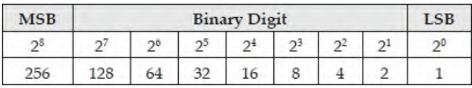
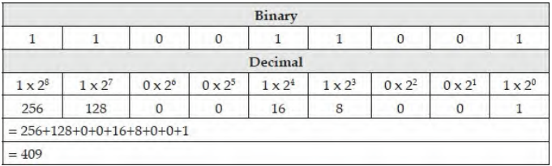
Binary

Slide 4
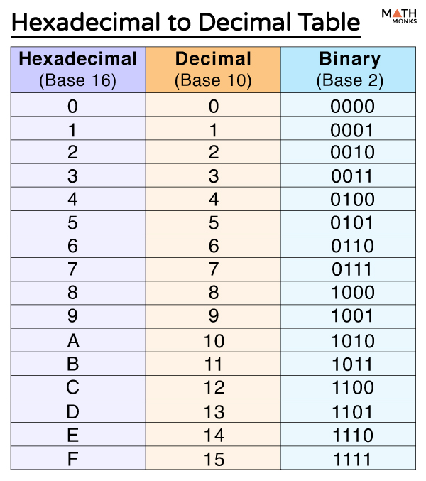
Hexadecimal (Base-16)

Slide 5
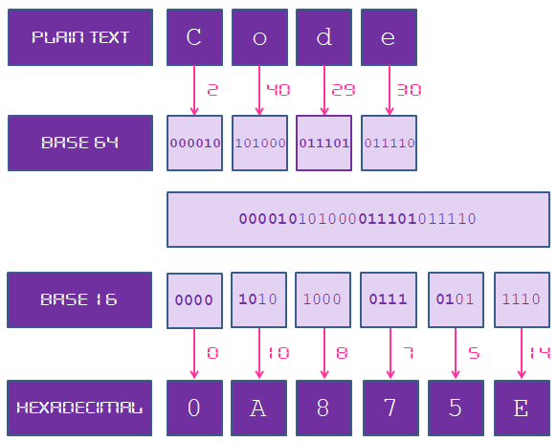
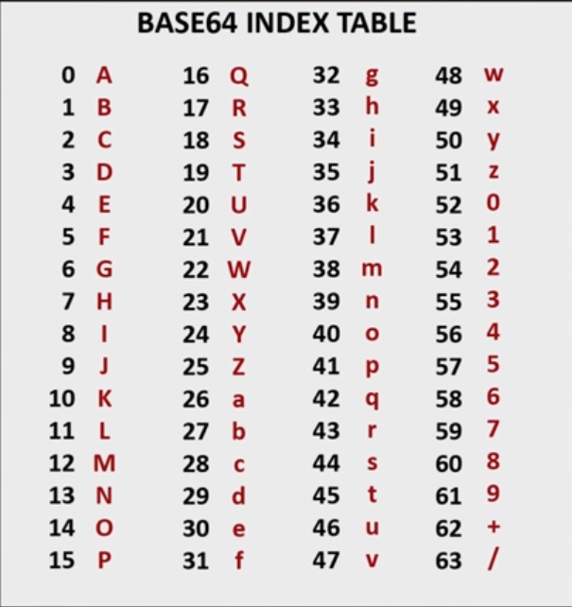
Hexadecimal (Base-64)

Slide 6
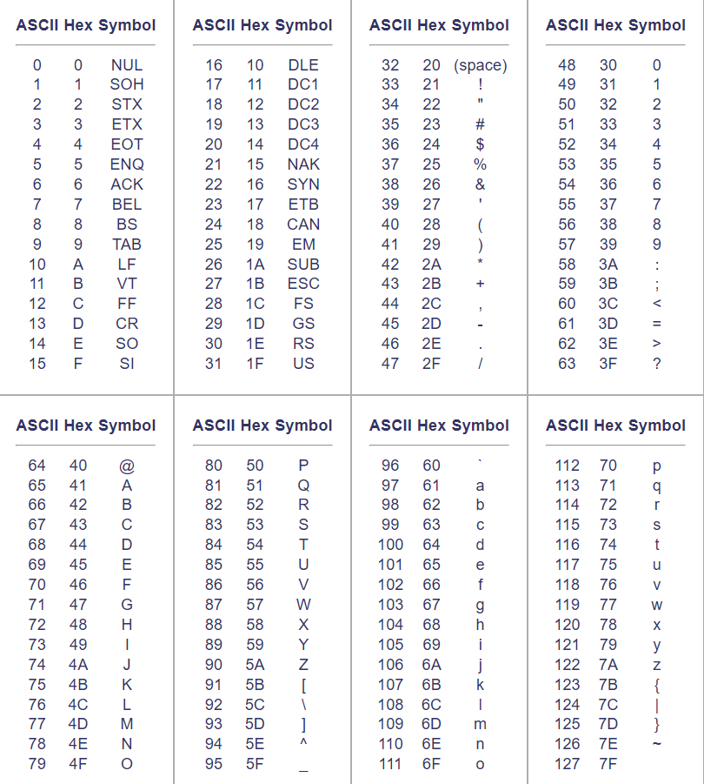
Character encoding schema
ASCII

Slide 7
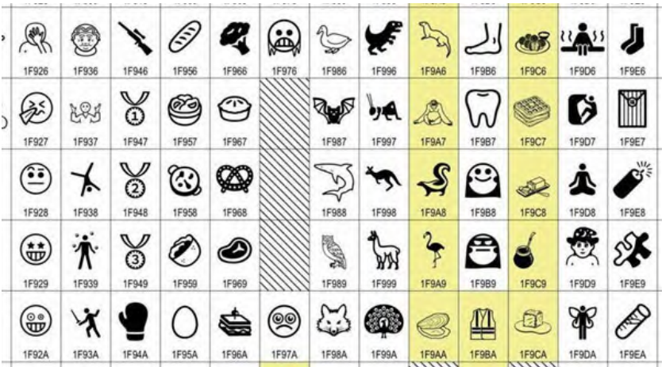
Character encoding schema
Unicode: UTF-8, UTF-16, and UTF-32

Slide 8
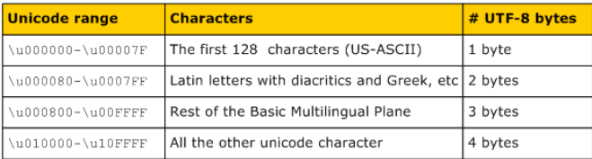
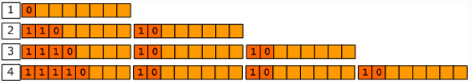
UTF-8
UTF-8, each code point is represented by a sequence of one or more bytes (variable sequence of bytes).

Slide 9
Bài tập
Biểu diễn tên hoặc họ sv = tiếng Việt (có dấu) bằng mã UTF-8
Tìm mã Unicode tương ứng của các ký tự tạo nên tên/họ (bao gồm cả dấu)

Slide 10
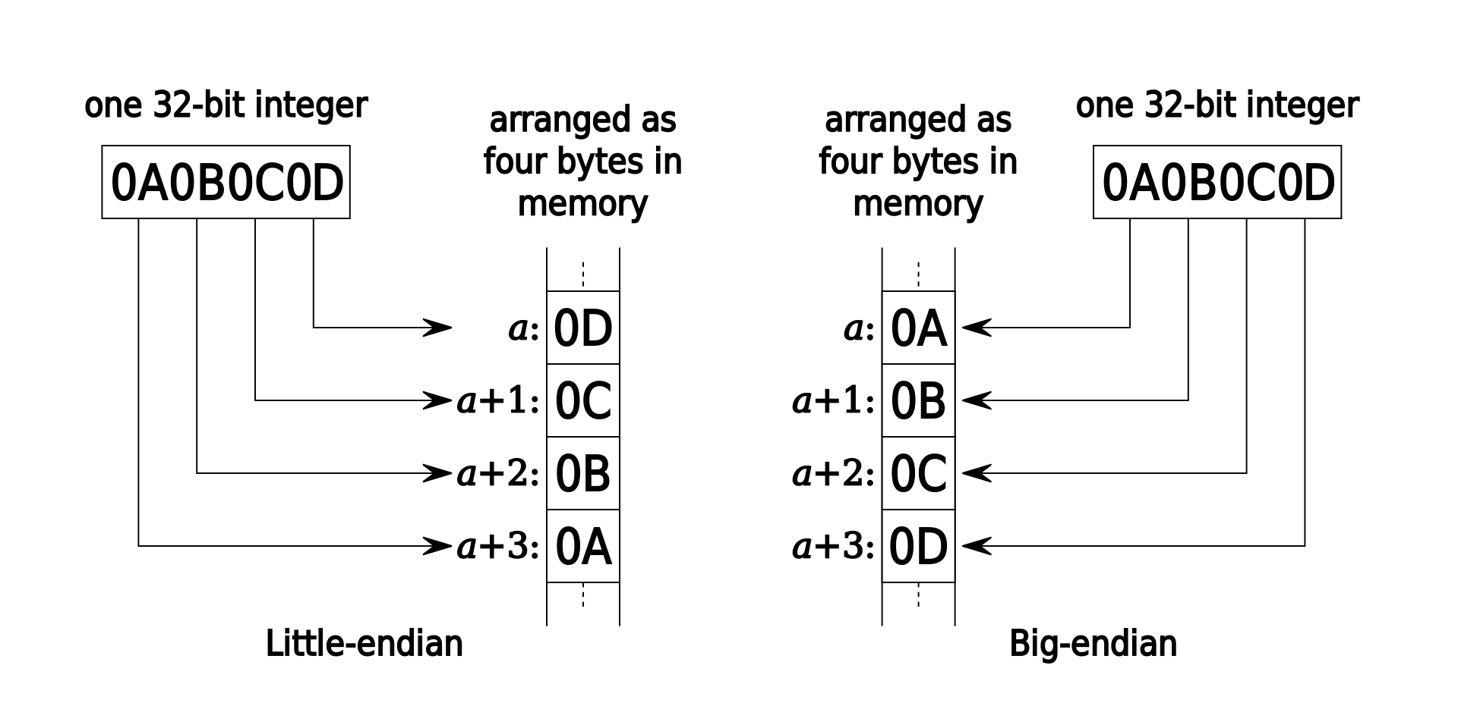
Little- and Big-Endianness

Slide 11
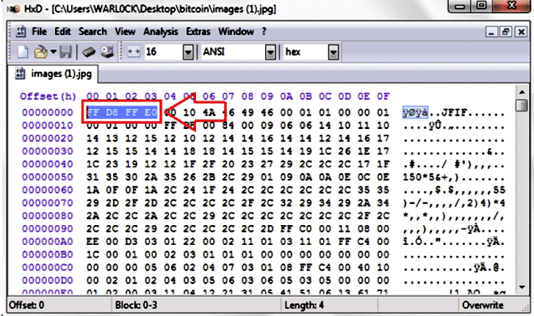
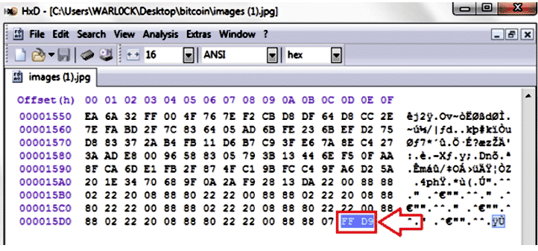
File Carving
recover and open a file from unallocated disc space on the target hard disk drive or from a raw dataset without using the software that produced the file (e.g, MS Word). This method is known as file carving
it may be used to recover lost files and file fragments from erased or damaged hard drives.

Slide 12
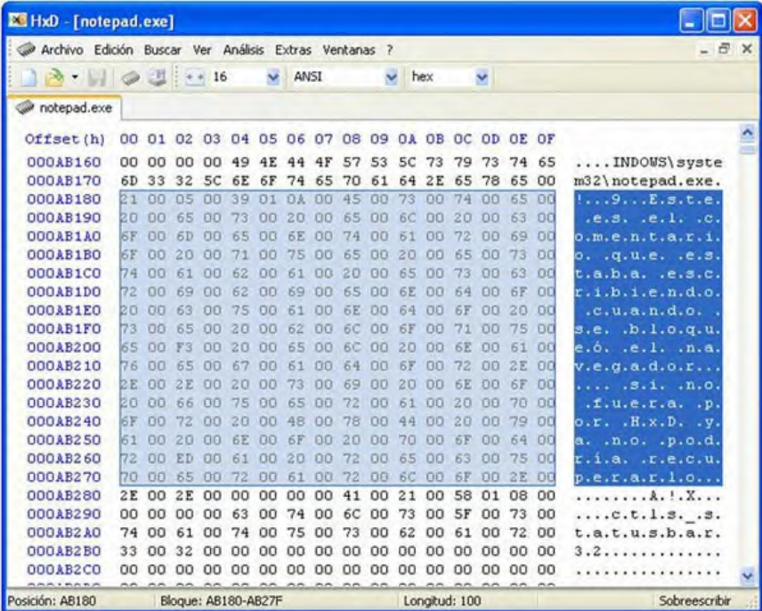
File Structure
Each file type has its encoding scheme that specifies how information is kept, and a digital file is made up of a series of bits. This schema’s name is “file format”.
File signature (header) can be checked to establish the type of strategy to detect it. The first 20 bytes of most digital files contain a signature;
HexEditor

Slide 13
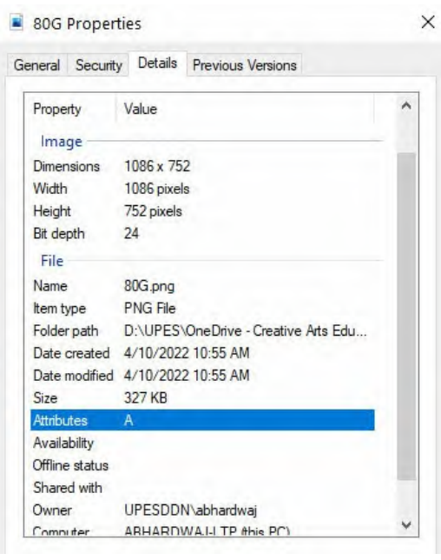
Digital file metadata
Metadata is information about information.
Metadata contains information about the file with which it is related
Author name, organization name, computer name, date/time produced, and comments

Slide 14
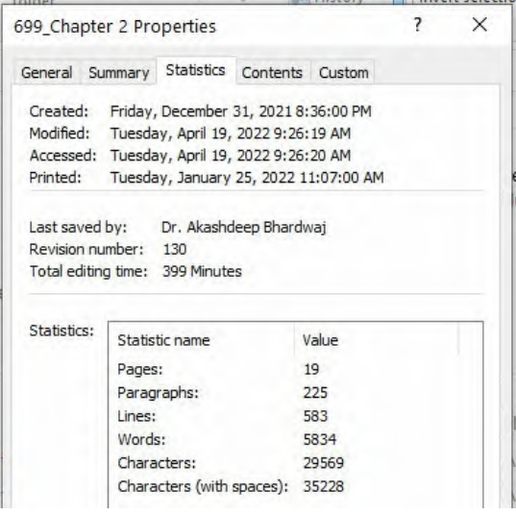
Timestamps decoder
Digital files contain a variety of information, the most essential of which is the timestamp metadata, which is used to indicate various date/time events related to the file of interest, such as the last access date/time, the last updated date, and the creation date.

Slide 15
Exercise
Read file header using
exiftool(-k).exe
Examine the code for getting the header of a PDF file at:
https://github.com/manuelpellegrinet/get-file-metadata
Examine the code for getting the header of a Image file at:
https://stackoverflow.com/questions/21697645/how-to-extract-metadata-from-an-image-using-python

Slide 16
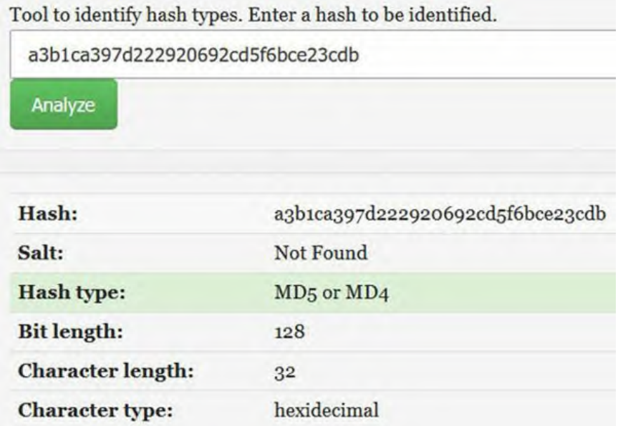
Hash analysis
Hashing (digital fingerprinting), is used in digital forensics investigations the first time to ascertain the acquired forensics image even before analysis begins (to make identical copies of the acquired forensics image) and then the second time after the investigation to verify the integrity of the data and forensics processing
https://www.tunnelsup.com/hash-analyzer/

Slide 17
System memory
Volatile memory
RAM
Non-Volatile memory
hard drives, flash memory, and ROM

Slide 18
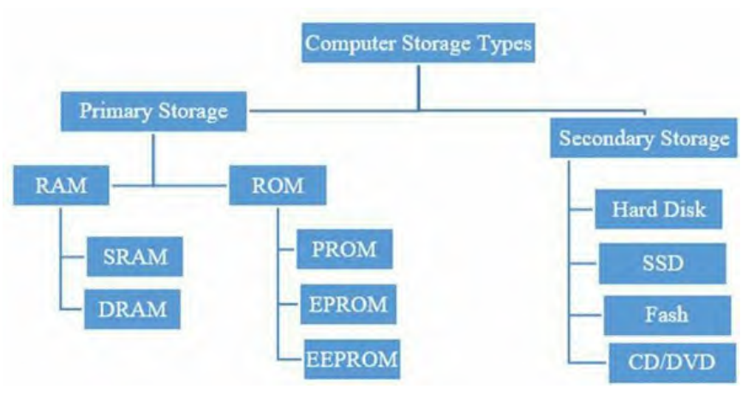
Computer memory storage

Slide 19
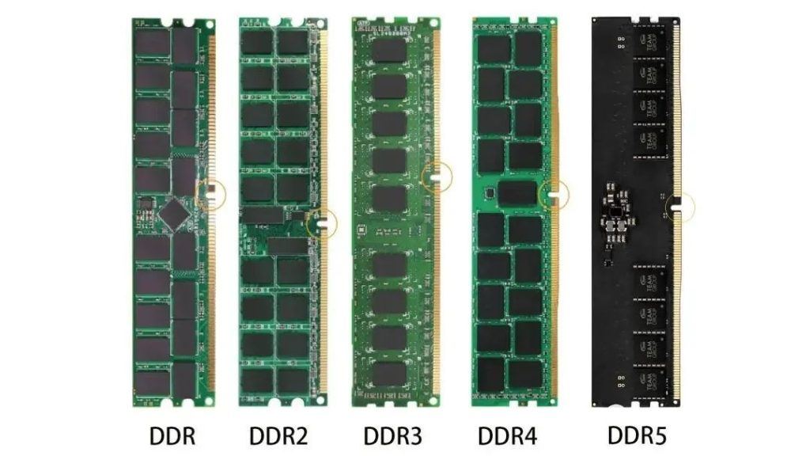
RAM
Dynamic RAM (DRAM) is the first type of memory where “dynamic” refers to the fact that to keep its data, this memory must be updated each second.
DRAM (DDR2, DDR3, DDR4, DDR5) where DDR stands for Double Data Rate)
Static RAM (SRAM) is used in CPU memories
(CPU Cache) and is extremely fast (faster than DRAM) because it does not require constant refresh (thus, the word “static”)
SRAM can be found in the CPU cache (L1 or Level 1) and on some chips on the motherboard (L2/L3)

Slide 20
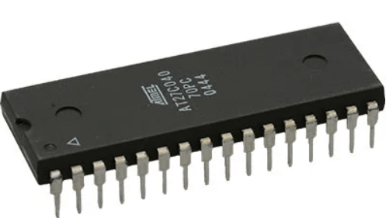
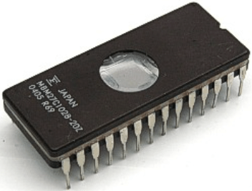
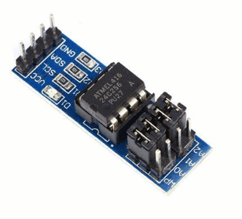
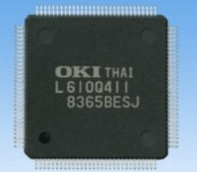
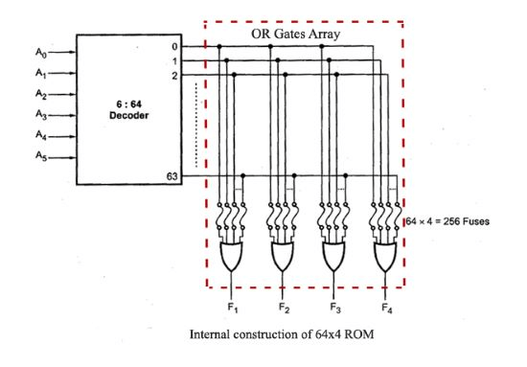
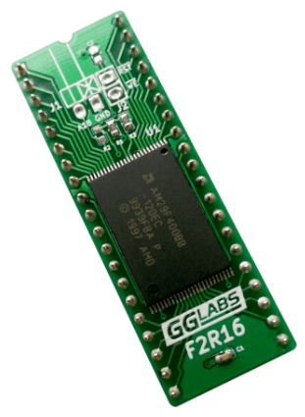
ROM
PROM
EPROM
EEPROM
FLASH ROM

Slide 21
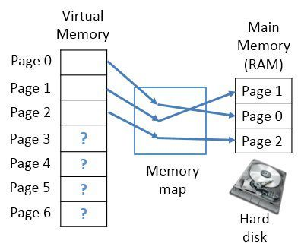
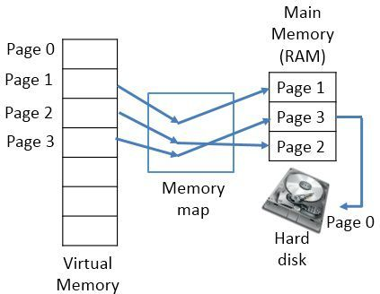
RAM, the paging file, and cache in DF
OSs can use a portion of the hard disk as an extension of RAM (a.k.a virtual memory). Although the hard drive is much slower than the RAM, the swap file or paging file on the disk can store files and programs that are being accessed less, leaving the RAM available to store data that is frequently accessed.

Slide 22
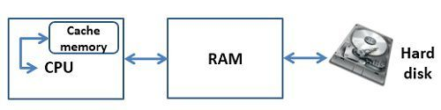
RAM, the paging file, and cache in DF
A Cache memory is a high-speed memory which is used to reduce the access time for data.
Unlike virtual memory, Cache is a storage device implemented on the processor itself.
In forensics investigations, the paging file is very important to us. Although not as volatile as RAM itself due to being stored on the hard disk, it is a hidden file in Windows called pagefile.sys. It can be found in the HKEY_LOCAL_MACHINE\SYSTEM\CurrentControlSet\Control\Session Manager\Memory Management

Slide 23
Exercise
Virtual memory setup 1.5 ~ 2 times of RAM
System managed
Manual
Live RAM capture tools
DumpIt
MAGNET RAM Capture
Belkasoft RAM Capture
FTK imager

Slide 24
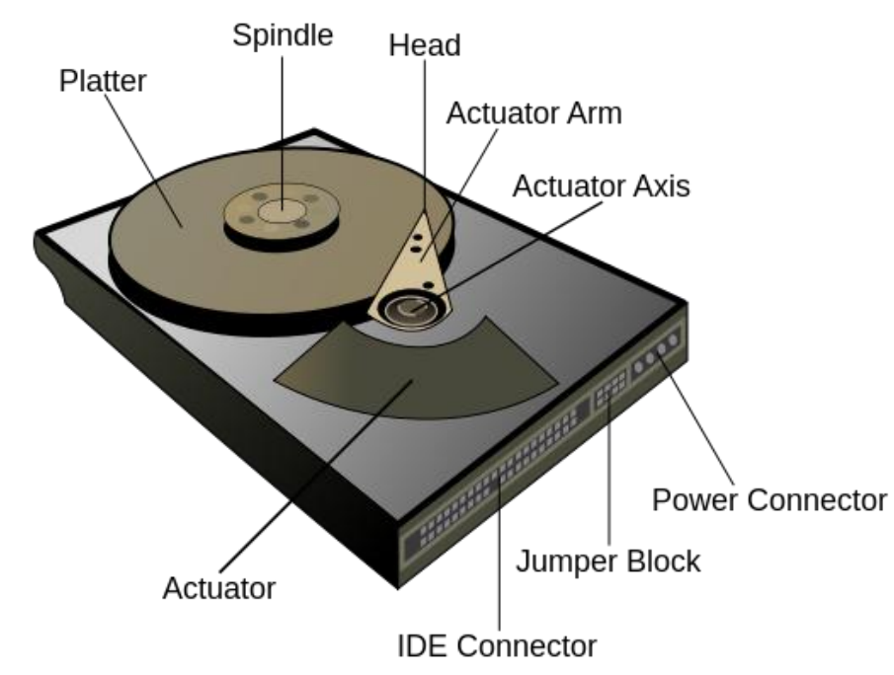
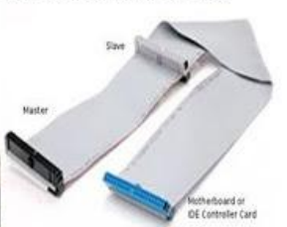

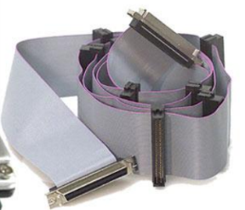
Hard disk drives (HDD)
It stores data using magnetic storage technology for later use.
There are two types of HDD drives: fixed (internal) and external.
Interfaces:
Parallel Advanced Technology Attachment (PATA)
Integrated Drive Electronics (IDE)
Serial Advanced Technology Attachment (SATA)
USB
SAS (Serial attached SCSI)

Slide 25
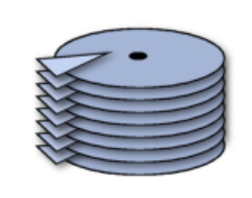
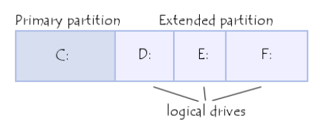
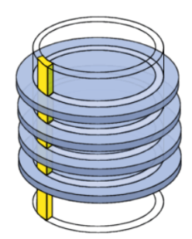
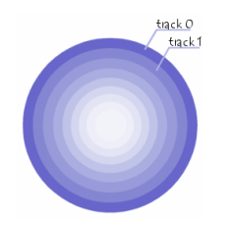
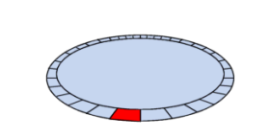
HDD
Low-Level Formatting
track
sector
cylinder
Platter
cluster
High-level formatting
A disk may contain up to four primary partitions (only one of which can be active), or three primary partitions and one extended partition.
In the extended partition, the user can create logical drives
Notes:
Cluster size varies from 4 to 64 sectors, depending on the file system used and the partition size. With these default settings, a single cluster can store up to 64 KB of data.

Slide 26
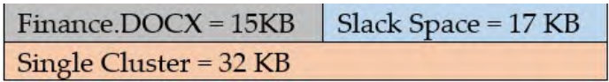
HDD
Slash space
a single cluster can store up to 64 KB of data. The remaining storage space will remain unused and is referred to as slack space.
Slack space can be used to store potentially incriminating data, or it can simply contain previously recycled leftover files that can be restored for evidence.
Lost cluster
Bad Sector
Master Boot Record
The boot sector (called the Master Boot Record or MBR) is the first sector of a hard drive (cylinder 0, head 0, sector 1), it contains the main partition table and the code, called the boot loader, which, when loaded into memory, will allow the system to boot up.
Disk Slack Checker https://www.karenware.com/powertools/ptslack

Slide 27
Exercise
Examine Disk: disk, partition, physical volume, logical volume,
Disk Management
Diskpart
MiniTool Partition Wizard
Slash check
Slash checker
Link:
https://www.minitool.com/partition-disk/volume-vs-partition.html

Slide 28
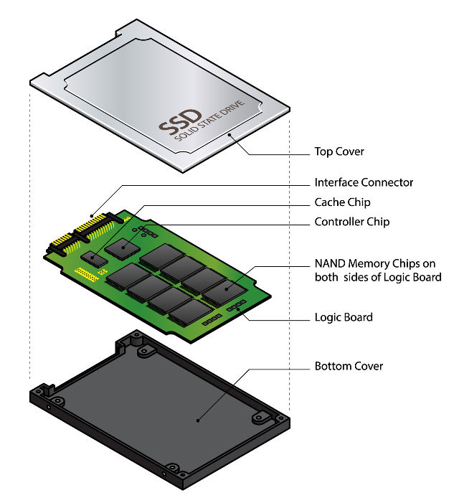
solid-state drive (SSD)
A solid-state drive (SSD) stores data using NAND flash memory (non-volatile).
SSDs have no moving parts (platters) and save data in a series of NAND flash cells or microchips, similar to flash memory.
Types of SSD interface:
M.2 NVMe (up to 32 Gb/s bandwidth)
M.2 SATA (up to 6 Gb/s bandwidth)
mSATA (up to 6 Gb/s bandwidth)
Data recovery from SSD is more difficult than data recovery from HDD, and it is sometimes impossible. When a user deletes a file, for example, the SSD will use the TRIM command, which works to delete a subject file instantly, leaving its location free for another file to occupy.

Slide 29
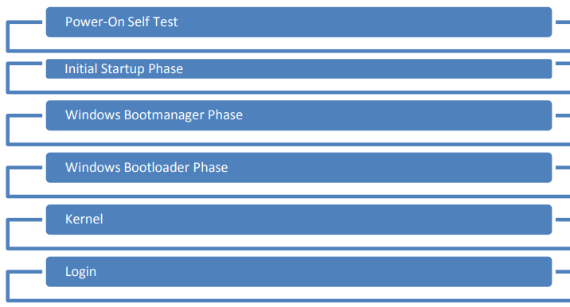
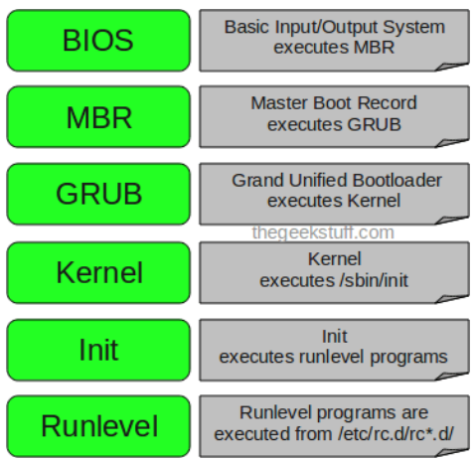
The Booting Process
Power Supply
BIOS and CMOS
POST tests
Reading the Partition Table
The Bootloader
The Kernel
OS Kernel
Windows
Linux

Slide 30
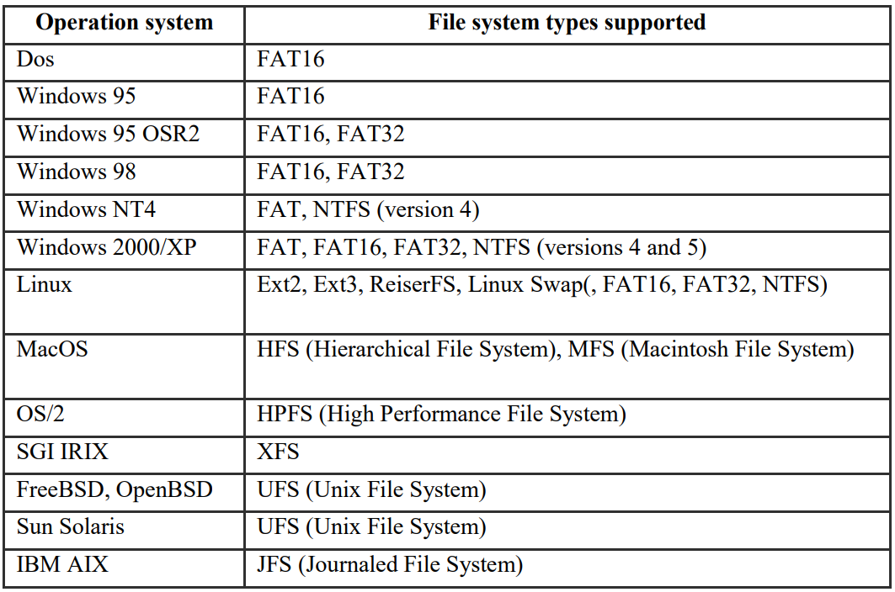
File Systems and OS

Slide 31
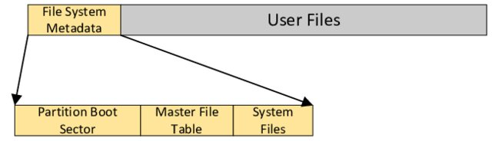
NTFS
Formatted NTFS volume including the master file table ($MFT), $Bitmap, $LogFile, and others, which contain information about all the files and folders on the NTFS volume. Max 256 TB.
Each file in the NTFS file system is made up of many data streams:
The primary stream (which has no name) contains the data that a user sees when they open a file.
The alternative data stream is the other stream (ADS) which is invisible to users
Master File Table (MFT) contains a set of files maintaining the metadata used to implement the file system structure.
The NTFS file system uses about 1 MB for the metadata files and the first 16 records in the MFT

Slide 32
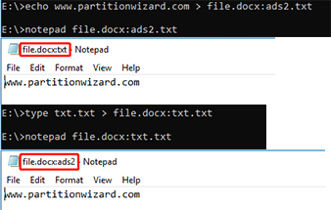
Alternate Data Streams (ADS)
It can store data related to the file like keywords, summaries, sound files, images, etc.
It can hide files. The Alternate Data Streams files can’t be seen and the host file will not become bigger or have any changes.
It can identify high risk files that shouldn’t be accessed.
The Windows Attachment Manager uses ADS as a file scanner to check whether the downloaded file is safe.
The SQL Database server uses ADS to maintain database integrity.
Citrix’s virtual memory uses ADS to boost DLL loading speed.
Anti-virus applications like Kaspersky use ADS to enhance the scanning technology.
An example of using ADS
However, because the Alternate Data Streams file is covert and executable, many hackers will use it to make viruses.

Slide 33
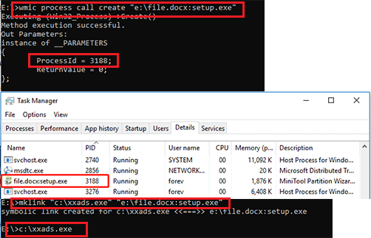
ADS
to run the ADS file, you can use the following 2 commands:
wmic process call create “ads file path” : it will give process ID
mklink “file path” “ads file path”: create a symbolic link for the ADS file. Then, run it.

Slide 34
Exercise
ADS file create, execution, detect and remove
https://www.minitool.com/partition-disk/alternate-data-streams.html

Slide 35
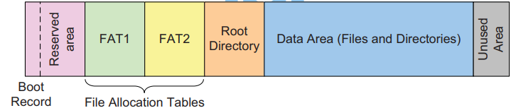
FAT
One of the oldest file systems still in use, file allocation table (FAT), comes in four flavors: FAT12, FAT16, FAT32, and FATX.
files are limited to 4GB in size and file names are case insensitive.
FAT is portable. Hence, it is used in many digital cameras, SD cards, smartphones, USB thumb drives, and embedded devices.

Slide 36

ext2, ext3 and ext4
Extended File System
Max file size: 16 TB; Volume size: 1 EiB.
The ext file systems are Linux's primary file systems and are usually the default option when installing Linux distributions.
The inode (index node) is a data structure in a Unix-style file system that describes a file-system object such as a file or a directory. Each inode stores the attributes and disk block locations of the object's data.

Slide 37
Types of file systems
Disk file systems
e FAT (FAT12, FAT16, FAT32), exFAT, NTFS
Optical discs: ISO 9660 and Universal Disk Format (UDF), ...
Flash file systems
Tape file systems
Magnetic tapes are sequential storage media with significantly longer random data access times than disks
Database file systems
Transactional file systems
Network file systems
Shared disk file systems
Special file systems
device file system

Slide 38
Environment for computing
personal computing
client-server computing
distributed computing
Cloud computing
Software as a service (SaaS)
G-docs, MS office 365
Platform as a service (SaaS)
Web development tools
Infrastructure as a service (SaaS)
physical server and data center hardware over the internet

Slide 39
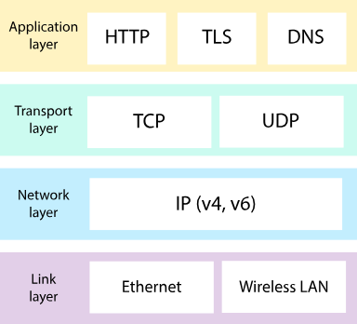
Internet Protocol Suite
Public IP addresses
Private IP addresses

